Slide 1
Offerly Online Auction
Douglas maxwell, Timothy holtz, Luke Mcelligott

Slide 2
AGENDA
INTRODUCTION
Motivation
Our Focus
Our Implementations
Summary
Future work

Slide 3
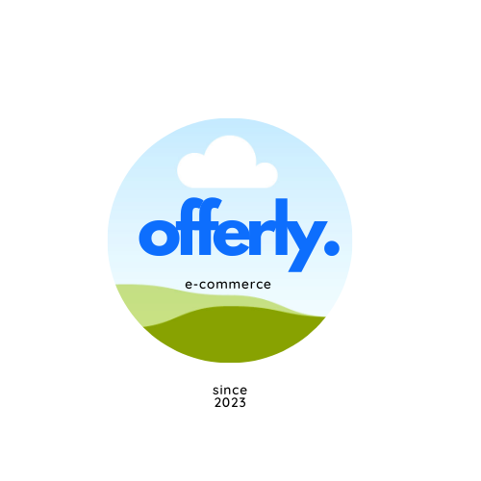
INTRO
Inherited online auction application
Offered simple ecommerce functionality
Goal of improving and adding features

Slide 4
motivation
Initial vision
Develop an ecommerce platform for a chemical company
Retail services, shipment tracking, appointment scheduling
Evolution
Modernize and improve the existing auction system
Purchasing, bidding, messaging, wishlisting

Slide 5
The problem at hand
Market Fragmentation
Traditional online retail platforms dominate
Homogeneous User Experience
Lack of User Interaction
Data Privacy Concerns
Monopolies
Addressing the Gap:
Our online auction platform seeks to bridge this gap by providing a dynamic, engaging, and community-driven e-commerce experience.

Slide 6
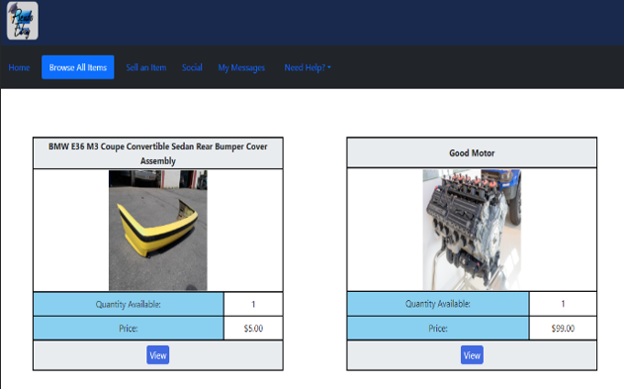
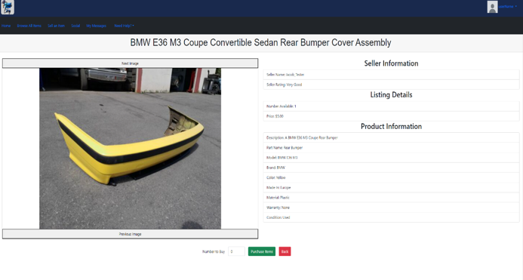
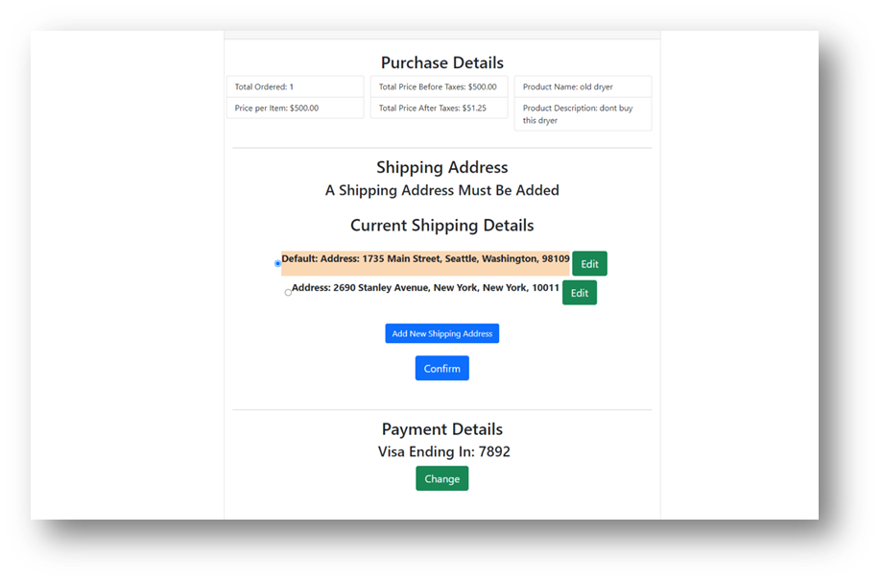
What we were given

Slide 7
What we focused on
UI/UX
Refactoring
Deployment
New Features
Upgrading the User Interface to be more modern, responsive, and accessible
Replacing complex solutions with efficient and scalable data structures
Improve the deployment process to simulate a live production environment
Add new features to the application as we go along.

Slide 8
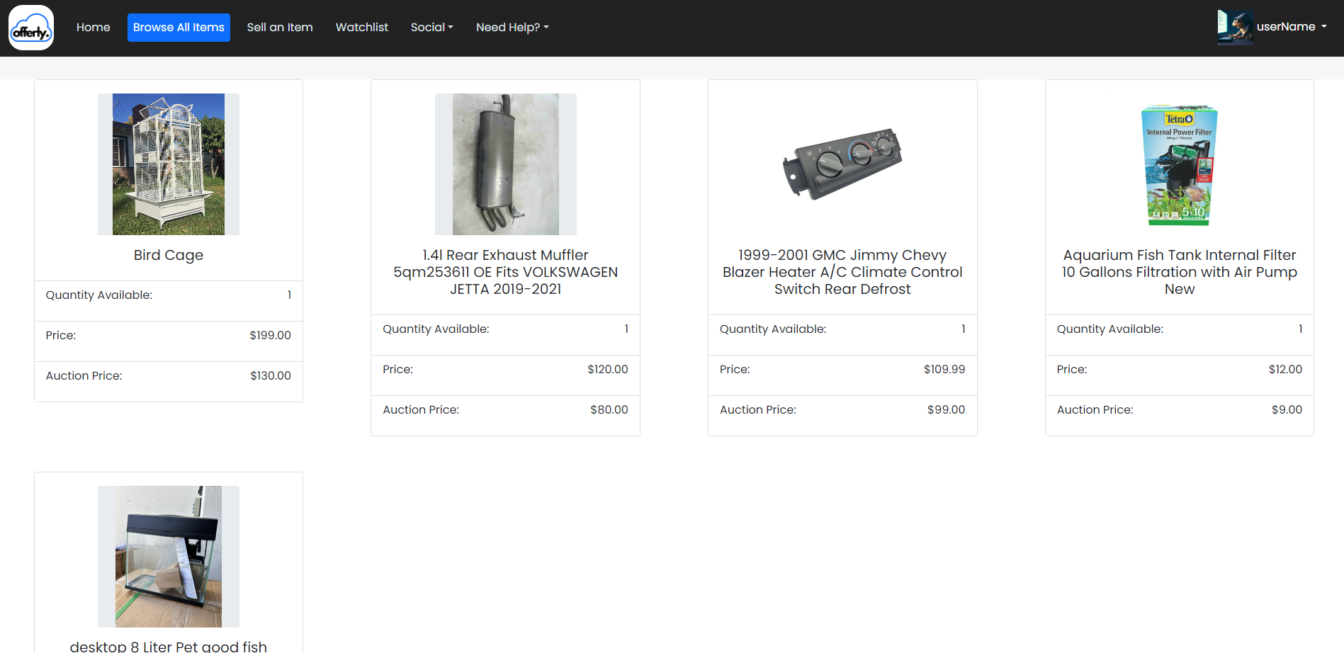
What we did – ui/ux
Revamped the entire application’s:
Color palette
Layout
Marketing Design
Accessibility

Slide 9
What we did – Refactoring
Condensed E-Commerce categories into scalable, living category tree
Supports adaptable attributes, and additional categories without hardcoding them in
Rebuilt several existing modules to increase clarity and functionality
Redesigned user sessions by authorizing requests via principal.

Slide 10
What we did – Deployment
Created a Continuous Integration (CI) pipeline for generating deployment files
Utilized tools like Spring Profiles and Context Paths to allow the application to run in several different environments and initialize the database
Created unit tests, integration tests, and underwent UATs
Deployed to a live server in the Robotics Lab, that supported multiple user sessions

Slide 11
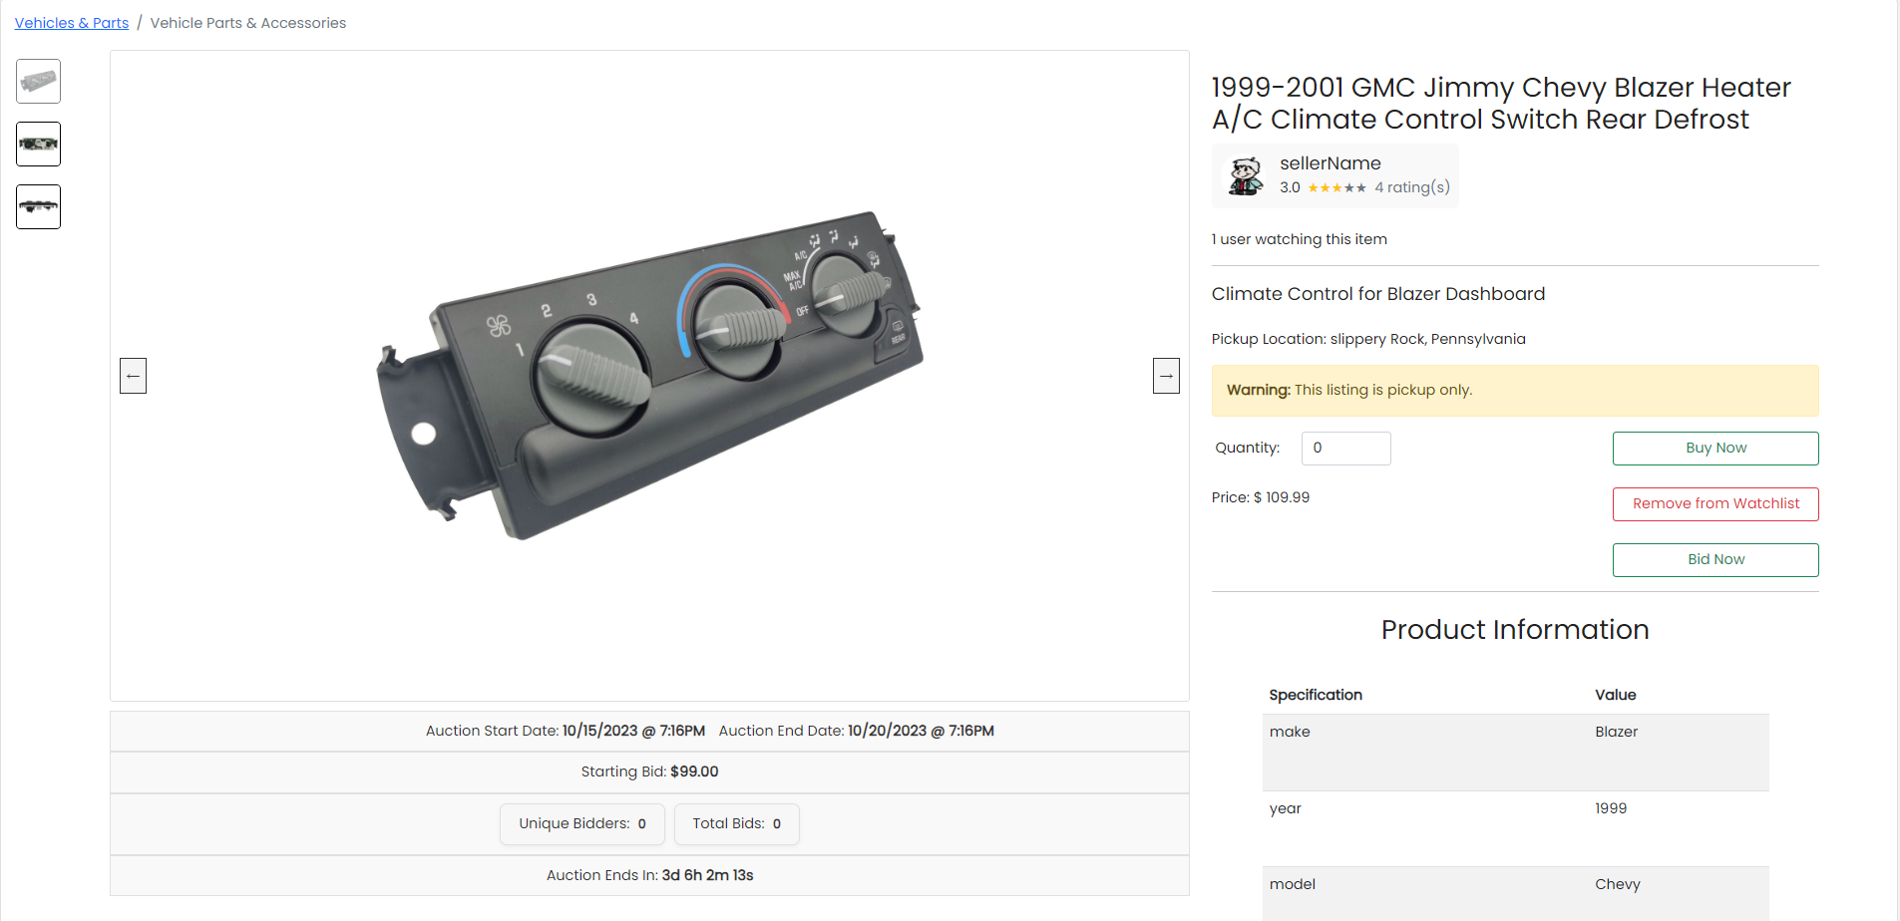
What we did – new features
Social Messaging
Bidding and AutoBidding
Two-Factor Authentication
Shipment Tracking
Watchlist
Admin Logs
Seller Ratings
Local Pickup Option

Slide 12
SUMMARY
Improved upon inherited auction system
UI/UX redesign
Application deployment
Code refactoring
New features and functionality

Slide 13
Future work
SSL Configuration
Product Filtering
Auction
Ticketing
Implementing SSL to provide HTTPS to boost security
Filtering for browsing products
Category
Price
Location
Remove expired auction listings
Automatically charge auction winner
Ticket category filtering
Ticket priority levels

Slide 14
THANK YOU
Douglas Maxwell – dsm1015@sru.edu
Timothy Holtz – tth1003@sru.edu
Luke McElligott – lpm1006@sru.edu

Slide 15
Demo

